Slide 1


CS-429 Introduction to Data Science
Instructor: Mubahir Iqbal
Fall 2024

Slide 2
Lecture outline
Exploratory Data Analysis
Correlation Analysis

Slide 3
Exploratory Data Analysis
EDA is a crucial first step in the data science process.
It involves examining your dataset to understand its structure, detect patterns, spot anomalies, and generate insights.
EDA typically helps you make decisions about data preprocessing and the types of analysis to apply later on.
import pandas as pd
data = pd.read_csv(r”your_dataset.csv”)

Slide 4
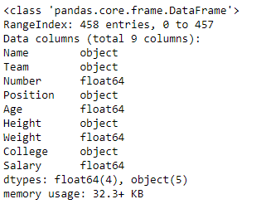
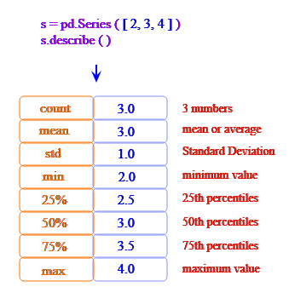
Steps of EDA
Understanding Data Structure
print(data.shape)
print(data.head())
print(data.info())
Descriptive Statistics
print(data.describe())
print(data['column_name'].value_counts())

Slide 5
Steps of EDA
Data Cleaning
Handling Missing Values: Identify and handle missing data, either by filling or dropping.
data = data.dropna(inplace=True)
2. Removing Duplicates: If there are duplicate rows, consider removing them.
data = data.drop_duplicates()

Slide 6
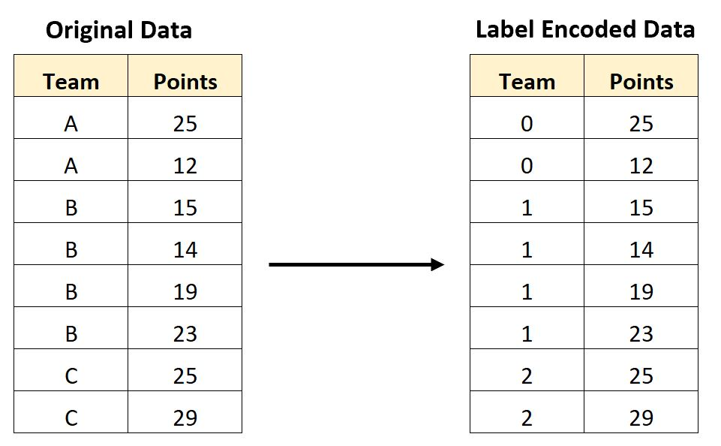
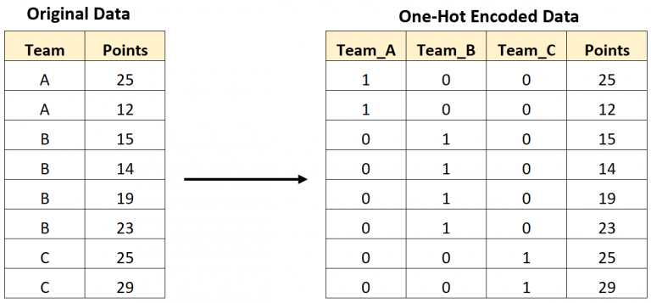
Steps of EDA
Encode Categorical Variables
Label Encoding: For ordinal categories, assign a unique integer to each category
One-Hot Encoding: For nominal (non-ordered) categories, create dummy variables (one column per category).

Slide 7
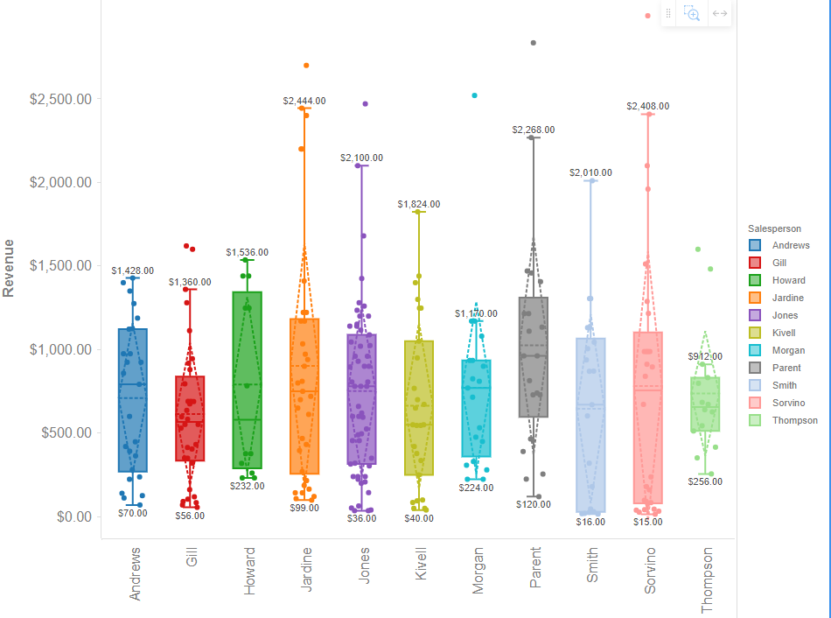
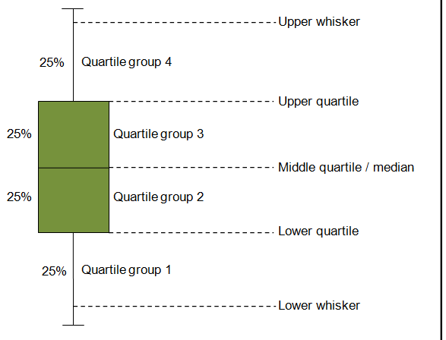
Steps of EDA
Identifying Outliers (Box-Plot)

Slide 8
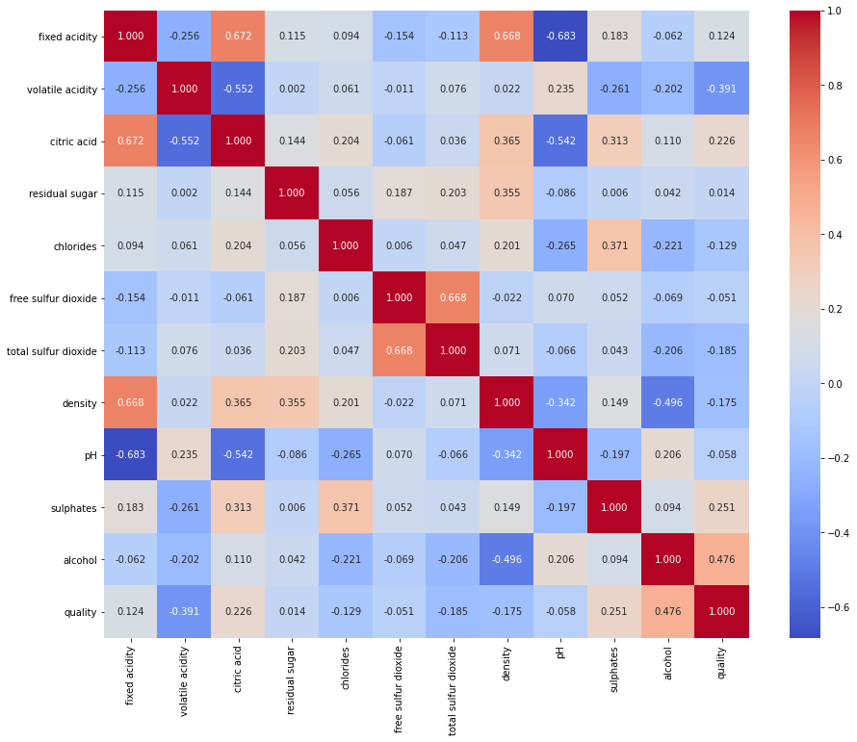
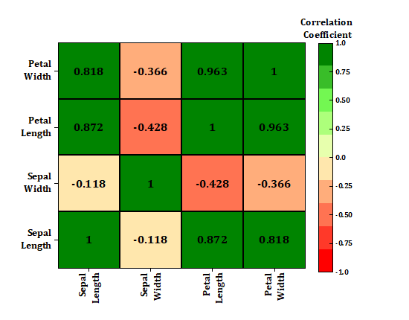
Steps of EDA
Heat Map (you already know and draw)

Slide 9
Correlation Analysis
Correlation analysis is a statistical technique.
It is used to evaluate the strength and direction of relationships between two or more variables.
Correlation coefficients, such as Pearson and Spearman, give values about which variables move together.
By analyzing these relationships, we find valuable insights into the data structure, feature dependencies, and potential multi-correlated, which can influence decisions about feature engineering, model selection, and predictive analysis.

Slide 10
Correlation Analysis
Pearson Correlation Coefficient
Spearman Rank Correlation Coefficient

Slide 11
Pearson Correlation Coefficient
Pearson correlation coefficient gives the linear relationship between two continuous variables.
The coefficient ranges from -1 to +1.
+1: Perfect positive linear relationship.
-1: Perfect negative linear relationship.
0: No linear relationship.
Pearson is best for normally distributed, continuous data with a linear relationship.

Slide 12
r=∑(X−Xˉ)2​⋅∑(Y−Yˉ)2​∑(X−Xˉ)(Y−Yˉ)​
Pearson Correlation Coefficient
For example, if you have age and blood pressure in a health dataset, a high Pearson coefficient would indicate that they change together linearly.
Formula

Slide 13
Pearson Correlation Coefficient
Example
Person ID | Age (X) | Glucose Level (Y)
1 | 43 | 99
2 | 21 | 65
3 | 25 | 79
4 | 42 | 75
5 | 57 | 87
6 | 59 | 81
The Correlation Coefficient is 0.5409

Slide 14
Pearson Correlation Coefficient
ID | Age (X) | Glucose Level (Y)
1 | 43 | 99
2 | 21 | 65
3 | 25 | 79
4 | 42 | 75
5 | 57 | 87
6 | 59 | 81
Total | 247 | 486
Mean | 247/6 = 41.16 | 486/6 = 81
Mean (x) = 41.16
Mean (y) = 81.0

Slide 15
Pearson Correlation Coefficient
ID | x | x-X | x-X | y | y-Y | y-Y
1 | 43 | 43 – 41.16 = | 1.84 | 99 | 99 – 81 = | 18
2 | 21 | 21 – 41.16 = | -20.16 | 65 | 65 – 81 = | -16
3 | 25 | 25 – 41.16 = | -16.16 | 79 | 79 – 81 = | -2
4 | 42 | 42 – 41.16 = | 0.84 | 75 | 75 – 81 = | -6
5 | 57 | 57 – 41.16 = | 15.84 | 87 | 87 – 81 = | 6
6 | 59 | 59 – 41.16 = | 17.84 | 81 | 81 – 81 = | 0
Total | 247 |  | 0.04 | 486 |  | 0.0
= (43–41.16)(99–81) + (21–41.16)(65–81) + (25–41.16)(79–81) + (42–41.16)(75–81) + (57–41.16)(87–81) + (59–41.16)(81–81)

Slide 16
Pearson Correlation Coefficient
ID | x | x-X | y | y-Y | (x-X)(y-Y) | (x-X)(y-Y)
1 | 43 | 1.84 | 99 | 18 | (1.84) x (18) | 33.12
2 | 21 | -20.16 | 65 | -16 | (-20.16) x (-16) | 322.56
3 | 25 | -16.16 | 79 | -2 | (-16.16) x (-2) | 32.32
4 | 42 | 0.84 | 75 | -6 | (0.84) x (-6) | -5.04
5 | 57 | 15.84 | 87 | 6 | (15.84) x (6) | 95.04
6 | 59 | 17.84 | 81 | 0 | (17.84) x (0) | 0
Total | 247 | 0.04 | 486 | 0.0 |  | 478.0
= 478.0

Slide 17
Pearson Correlation Coefficient
2. Finding the lower equation
ID | x | x-X | (x-X)2 | y | y-Y | (y-Y)2
1 | 43 | 1.84 | 3.3856 | 99 | 18 | 324
2 | 21 | -20.16 | 406.4256 | 65 | -16 | 256
3 | 25 | -16.16 | 261.1456 | 79 | -2 | 4
4 | 42 | 0.84 | 0.7056 | 75 | -6 | 36
5 | 57 | 15.84 | 250.9056 | 87 | 6 | 36
6 | 59 | 17.84 | 318.2656 | 81 | 0 | 0
Total | 247 | 0.04 | 1240.8336 | 486 | 0.0 | 656

Slide 18
Pearson Correlation Coefficient
Calculate and see the Python Code
Answer = 0.5409

Slide 19
Spearman Rank Correlation Coefficient
Spearman correlation measures the monotonic relationship between two variables.
This means it assesses if one variable increases as the other increases, but not necessarily at a constant rate.
Spearman’s range is also from -1 to +1
+1: Perfect positive linear relationship.
-1: Perfect negative linear relationship.
0: No linear relationship.
Spearman is useful for non-linearly related or non-normally distributed data.

Slide 20
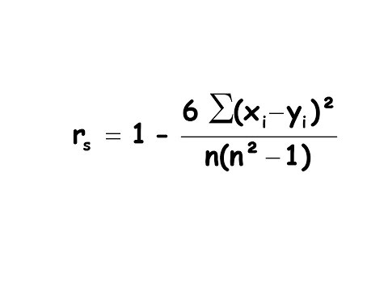
Spearman Rank Correlation Coefficient
Spearman works well for ranked or non-normally distributed data and captures monotonic (not necessarily linear) relationships
Formula

Slide 21
Spearman Rank Correlation Coefficient
Example
The marks of nine students in physics and math are:
Physics: 35, 23, 47, 17, 10, 43, 9, 6, 28
Mathematics: 30, 33, 45, 23, 8, 49, 12, 4, 31
Compute the students’ranks in both subjects and then
compute the Spearman rank correlation.
ID | Phy | Math
1 | 35 | 30
2 | 23 | 33
3 | 47 | 45
4 | 17 | 23
5 | 10 | 8
6 | 43 | 49
7 | 9 | 12
8 | 6 | 4
9 | 28 | 31

Slide 22
Spearman Rank Correlation Coefficient
1. Define Ranking in each subject
ID | Phy (x) | Rank in Phy | Math(y) | Rank in Math
1 | 35 | 3 | 30 | 5
2 | 23 | 5 | 33 | 3
3 | 47 | 1 | 45 | 2
4 | 17 | 6 | 23 | 6
5 | 10 | 7 | 8 | 8
6 | 43 | 2 | 49 | 1
7 | 9 | 8 | 12 | 7
8 | 6 | 9 | 4 | 9
9 | 28 | 4 | 31 | 4

Slide 23
Spearman Rank Correlation Coefficient
2. Find difference (di) between ranking
ID | Phy (x) | Rank in Phy | Math(y) | Rank in Math | di
1 | 35 | 3 | 30 | 5 | -2
2 | 23 | 5 | 33 | 3 | 2
3 | 47 | 1 | 45 | 2 | -1
4 | 17 | 6 | 23 | 6 | 0
5 | 10 | 7 | 8 | 8 | -1
6 | 43 | 2 | 49 | 1 | 1
7 | 9 | 8 | 12 | 7 | 1
8 | 6 | 9 | 4 | 9 | 0
9 | 28 | 4 | 31 | 4 | 0

Slide 24
Spearman Rank Correlation Coefficient
3. Square the difference (di)
ID | Phy (x) | Rank in Phy | Math(y) | Rank in Math | di | di Square
1 | 35 | 3 | 30 | 5 | -2 | 4
2 | 23 | 5 | 33 | 3 | 2 | 4
3 | 47 | 1 | 45 | 2 | -1 | 1
4 | 17 | 6 | 23 | 6 | 0 | 0
5 | 10 | 7 | 8 | 8 | -1 | 1
6 | 43 | 2 | 49 | 1 | 1 | 1
7 | 9 | 8 | 12 | 7 | 1 | 1
8 | 6 | 9 | 4 | 9 | 0 | 0
9 | 28 | 4 | 31 | 4 | 0 | 0
Total |  |  |  |  |  | 12

Slide 25
Spearman Rank Correlation Coefficient
4. Find lower portion of the formula
Total number of students = n = 9
= 9 ( sq(9) -1)
= 9 ( 81 -1)
= 9 ( 80) = 720

Slide 26
Spearman Rank Correlation Coefficient
5. Apply values
Sum squares of All differences in ranks = 12
= 720
Answer = 0.9

Slide 27
Spearman Rank Correlation Coefficient
Do the Rest and see the Python Code

Slide 28

Why Me? | Understanding Qadar with Dr. Omar Suleiman
URL: Why Me? | Understanding Qadar with Dr. Omar Suleiman | Ramadan Series 2024 TRAILER
Number of episodes: 30
Total Duration: 05 ~ 06 Hrs

